Slide 1
COS801 Project
By
Mudau Phathutshedzo Tiny

Slide 2
Introduction
Credit scoring is a method for determining how likely it is that a counterparty, current borrower, or loan applicant would default or go past due. For consumer loans, credit card use, and mortgage lending, it provides a forecast of the chance of default or delinquent.
Credit scoring is a tool that lenders use to decide whether or not to grant borrowers’ requests for credit. Condensing all of the information that is known about the borrower into a score is the goal of any credit scoring procedure. Credit is only granted if it is determined that the borrower’s credit score is higher than a predetermined cutoff.

Slide 3
Introduction
Application scoring and behavioral scoring are both used to assess new applicants and monitor current borrowers to determine whether their creditworthiness has changed. In order to assess both applications and behavioral data efficiently, lending organizations should have access to a significant sample of past customers as well as information on their applications and subsequent credit histories
In this project we are going to replicate thesis done by (Le Quy Tai and Giang Thi Thu Huyen, 2019) who did models of deep neural network (DNN) and Convolutional neural network (CNN) in 1D. We are going to extend the paper by applying other deep neural networks such as Long Short-Term Memory neural network.

Slide 4
Problem statement
Fintech’s advancements have made it possible for the financial services sector to conduct business in new ways. Financial institutions that lend money are currently under pressure to make their products more accessible to the market, to conduct credit underwriting that is more open and non-discriminatory, and to process loan applications more quickly than before. As a result, the processes for determining whether to provide credit or not need to be improved. The future of machine learning models is becoming more widely discussed due to ongoing debates by the European Banking Authority (EBA). The question we still have to answer is that, of the models that have been used and deep neural networks, which of them give the best results between good and bad borrowers? The aim of this current study is to explain predictions made by some of the commonly used methods and deep learning model in a credit scoring setting.

Slide 5
Approaches/Model/Methods/Algorithms description
With the exception of the Support Vector Machine on the German credit dataset, we will also employ standard techniques like Decision Trees, k-Nearest Neighbor, Naive Bayes, Multi-Layer Perceptrons, and Random Forest. We are also going to use deep learning methods such as ANN, LSTM and CNN.

Slide 6
Experimental description of the dataset and results
We use four real world datasets namely German Credit data, Australian Credit Approval, and HMEQ in credit scoring, to take the experiments with our deep neural networks. German Credit dataset was obtained from UCI Machine Learning repository, and Australian Credit Approval, and HMEQ datasets was obtained from Kaggle. This has been widely used in validating credit and behavioural scoring models, also in deep learning models. The German dataset has 7 features that are numerical and 13 that are categorical. Dataset have 700 cases of good credits and 300 cases of bad credits. The HMEQ dataset has 11 features that are numeric and two that are categorical.

Slide 7
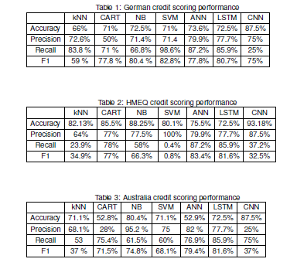
Results

Slide 8
Results
On the German credit data set, Table I shows how classifiers performed. With an accuracy measurement of almost 93%, ANN and CNN display their impressive capabilities. ANN has a classification accuracy of 87.2% when measured by F1 score. Contrary to popular belief, ANN performance outperforms SVM in terms of F1 score, despite SVM having the highest score on the Recall measurement. The performance of the ANN and CNN algorithms on an experiment with Australian credit data is excellent; Table II provides more specific results. The functionality of our approaches on the HMEQ data set is described in Table III. Every classifier performs well, scoring around 93.18% on the accuracy measurement. The greatest F1 score of our approaches, however, is 81%, indicating that they are sensitive to imbalance data.

Slide 9
References
C. Rudin, Stop explaining black box machine learning models for high stakes decisions and use interpretable models instead, Nature Machine Intelligence, vol. 1, no. 5, pp. 206-215, 2019.
S. Chari, D. M. Gruen, O. Seneviratne, and D. L.Mcguinness, Directions for Explainable Knowledge-Enabled Systems, 2020.
X. Dastile and T. Celik, Model-Agnotic counterfactua, explanations in credit score, open access journal, 2022.
L.Q. Tai and G.T Huyen, Deep learning techniques for credit scoring, Journal of Economics, Business and Management, 7(3), 2019.

